Slide 1





To Kill a Mutant – An Empirical Study of Mutation Testing Kills
Hang Du†, Vijay Krishna Palepu⋆, James A. Jones†
†University of California, Irvine, Irvine, USA
⋆Microsoft, Silicon Valley Campus, Mountain View, USA

Slide 2
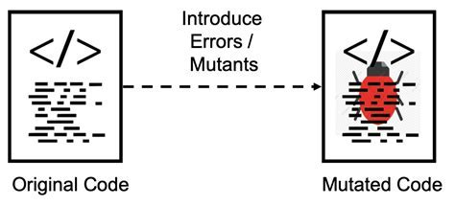
Background: Mutation Testing
Test failures kill the mutant
Purpose: Evaluate the quality of the test suite.
Image from https://learndevtestops.com/2019/12/11/mutation-testing-different-yet-powerful-way-of-testing-your-code/

Slide 3
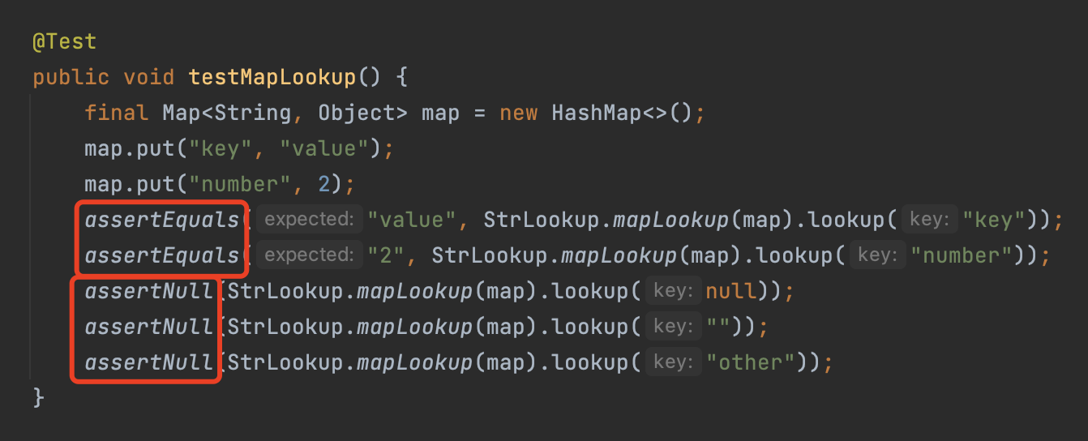
1. Test Oracles Kill the Mutant
Assumption
Test Oracles

Slide 4
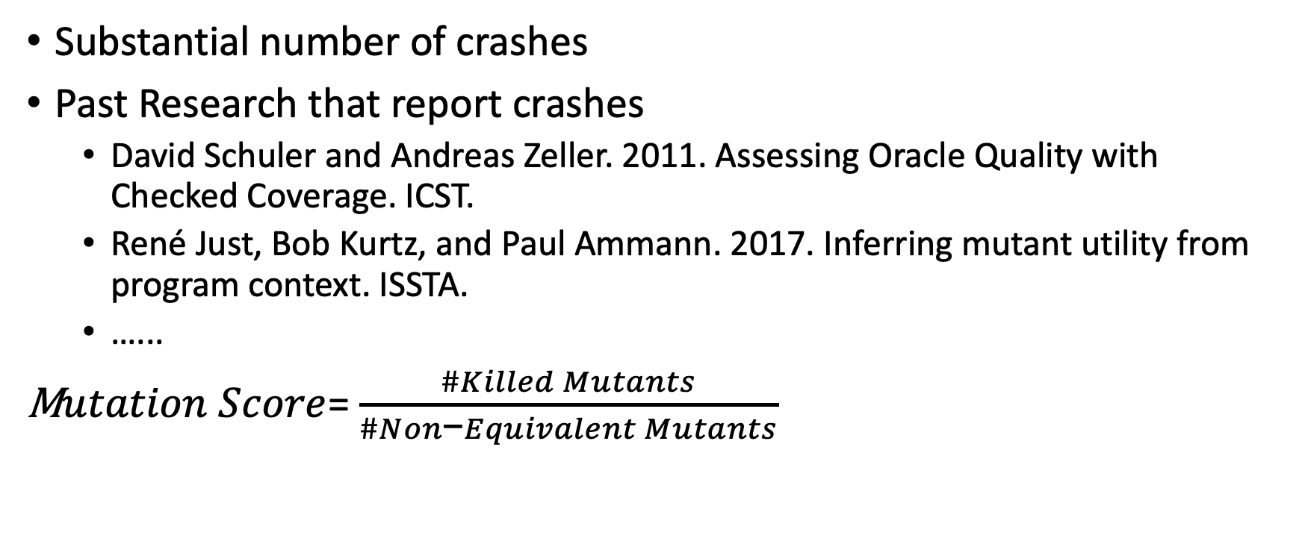
Crashes Kill Mutants
Substantial number of crashes
Past Research that report crashes
David Schuler and Andreas Zeller. 2011. Assessing Oracle Quality with Checked Coverage. ICST.
René Just, Bob Kurtz, and Paul Ammann. 2017. Inferring mutant utility from program context. ISSTA.
…...
M$utation Score$= $\frac{\#Killed Mutants}{\#Non\text{−}Equivalent Mutants}$
crashes

Slide 5
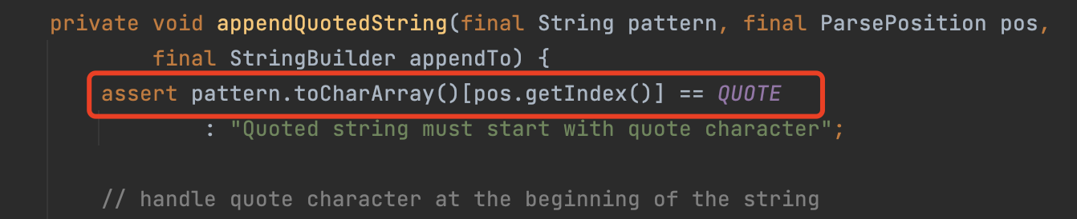
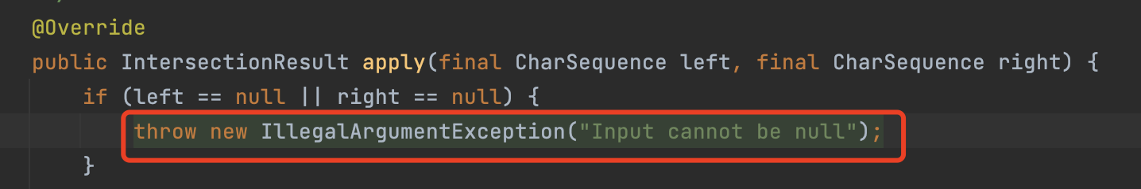
2. Source-code Oracles Kill the Mutant
Source-Code Oracles
Defensive Programming
Pre-condition/Post-condition Checks

Slide 6
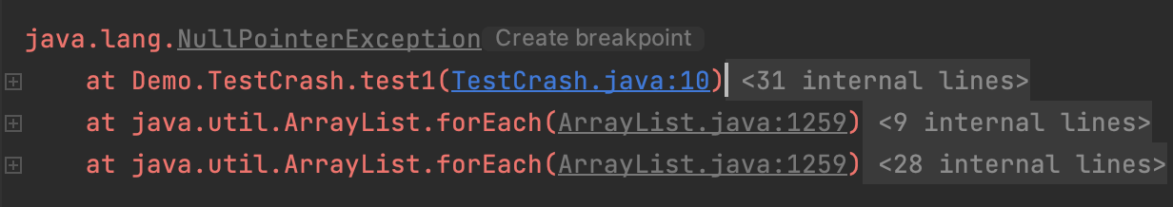
3. Exogenous Crashes Kill the Mutant
Exogenous Crashes
Java Virtual Machine
Third-Party Libraries

Slide 7
Taxonomy of Mutant Killing Reasons
1. Test Oracle Failures
2. Source-code Oracles Failures
3. Exogenous Crashes
Evaluate the Test Suite?

Slide 8

Experiment
Approach:
Customized Instrumentation (ASM)
PIT extension
10 open-source Java projects with human-written tests
PIT
50, 000 mutants
2.5 million test runs
https://github.com/spideruci/MutationKills

Slide 9
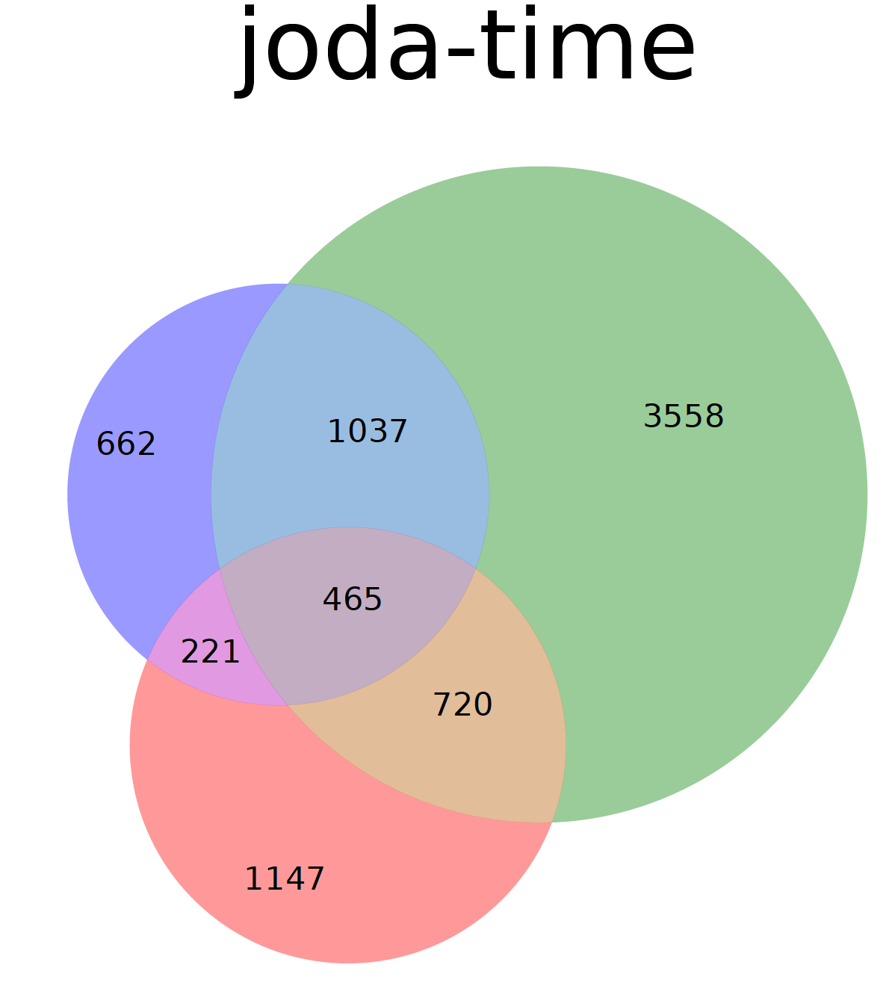
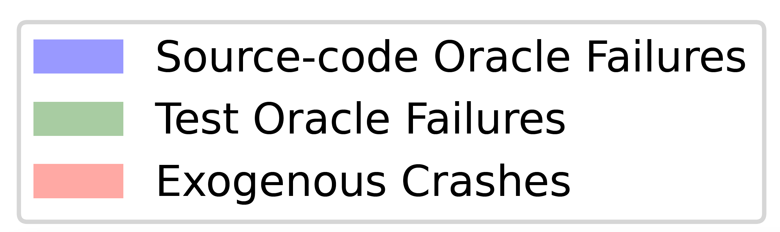
Results
Mutant Killing Sources

Slide 11
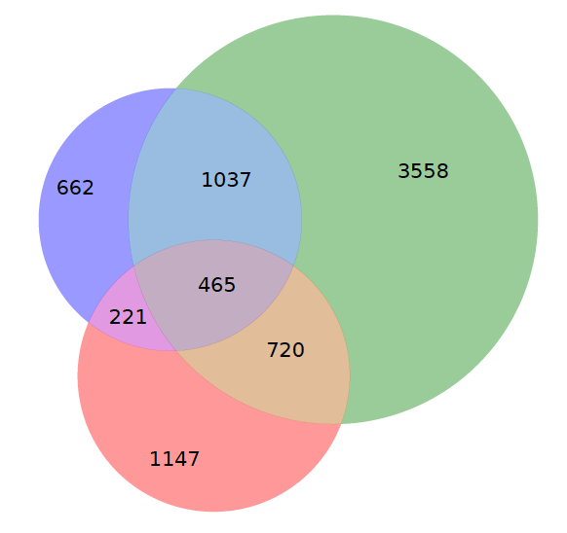
Observation
Failing Test Runs
Mutant Kills
Surprisingly, non-test-oracle failures account for more than 55% of test failures, on average
Among our subjects, test oracles contributed as little as 11.8% of test failures (45%, on average)
As much as 21.3% of all killed mutants can be killed due to all of the failure causes
Up to 47% of killed mutants can be killed in multiple ways.

Slide 12
Implication
Mutation testing evaluates more of the software overall robustness
Users need to understand the composition of mutation score
Users have other options to kill the mutant
Relative importance of failing causes remains to be investigated
Researchers may devise weighted/specialized mutation metrics

Slide 13
Observation(exogenous crashes)
Dominated exception types:
Some mutators-exception pairs contribute to a major proportion of crashes
Some mutation operators tend to lead to exogenous crashes and are related to specific type of exceptions
NullPointerException
StringIndexOutOfBounds
ArrayIndexOutOfBounds
IndexOutOfBounds

Slide 14
Implication
New techniques to augment the software
Recommend source code oracles
Mutation operators for different tasks
Mutation testing for test assertions
Crash Replication

Slide 15
To Kill a Mutant – An Empirical Study of Mutation Testing Kills
Hang Du†, Vijay Krishna Palepu ⋆, James A. Jones†

Slide 17
Unveiled
Impact on Redundant mutant, Subsuming mutant, trivial mutant
A Better way to implement mutation testing tool
Impact on mutation-based analysis
Mutation-based fault-localization
Mutation-based test prioritization
Choices made by developers
Discovering better mutation operators?
What is better?

Slide 18
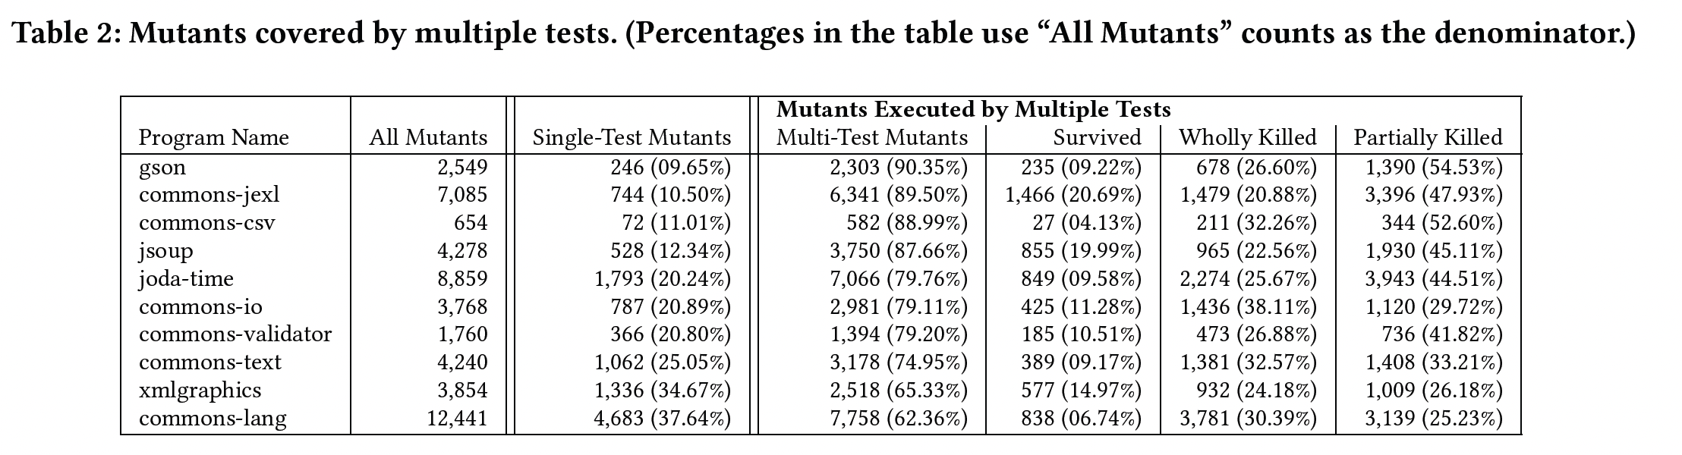

Slide 19
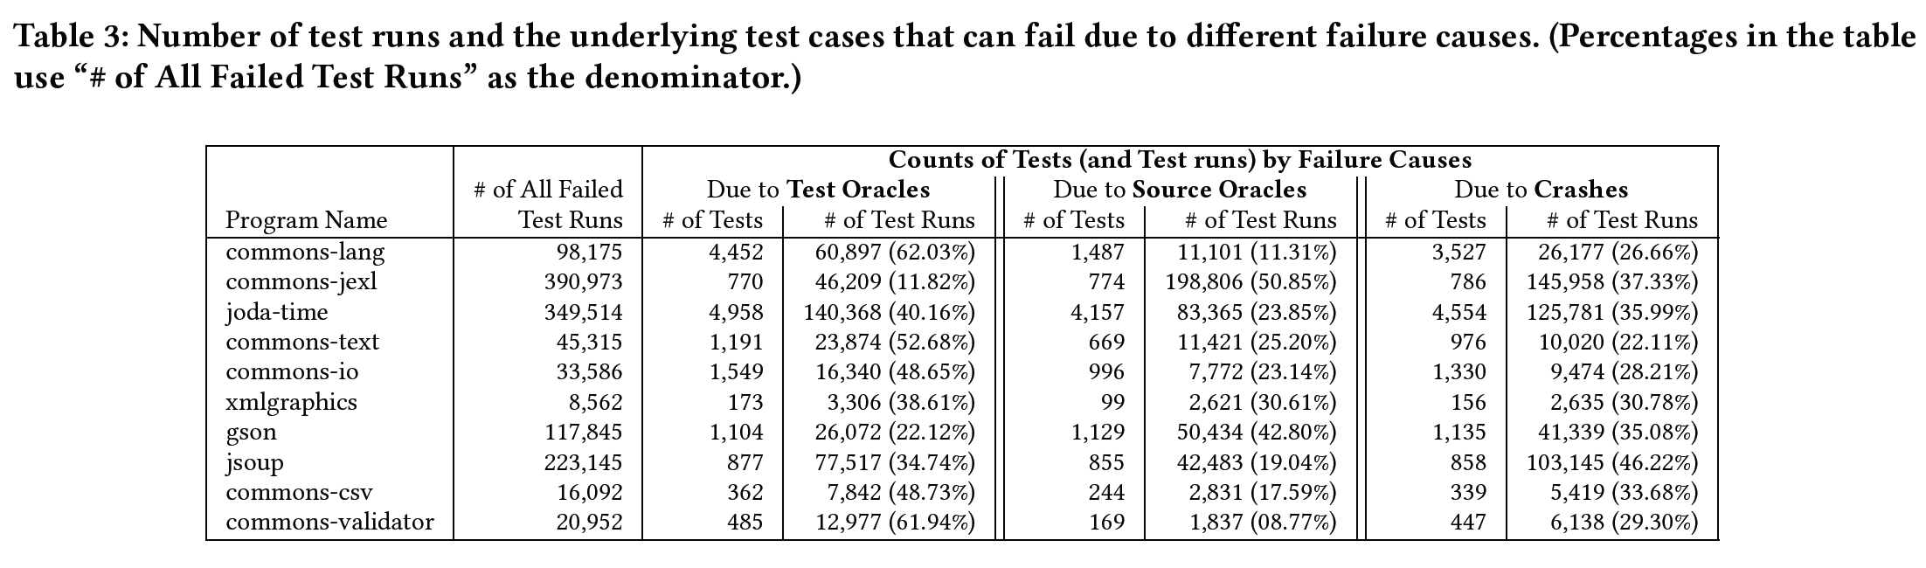

Slide 20
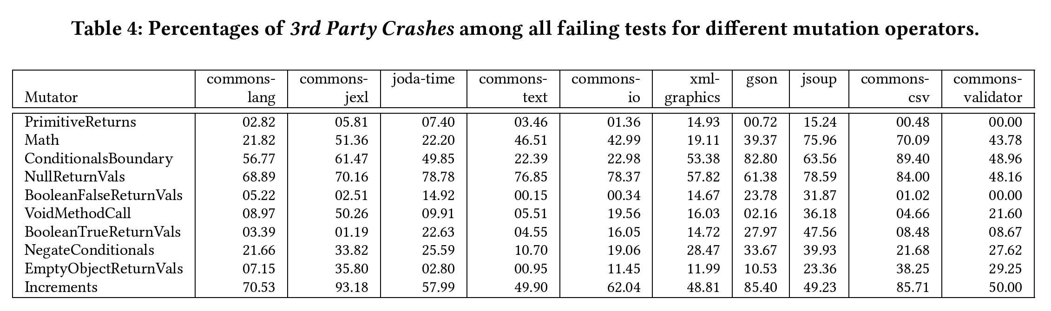

Slide 21
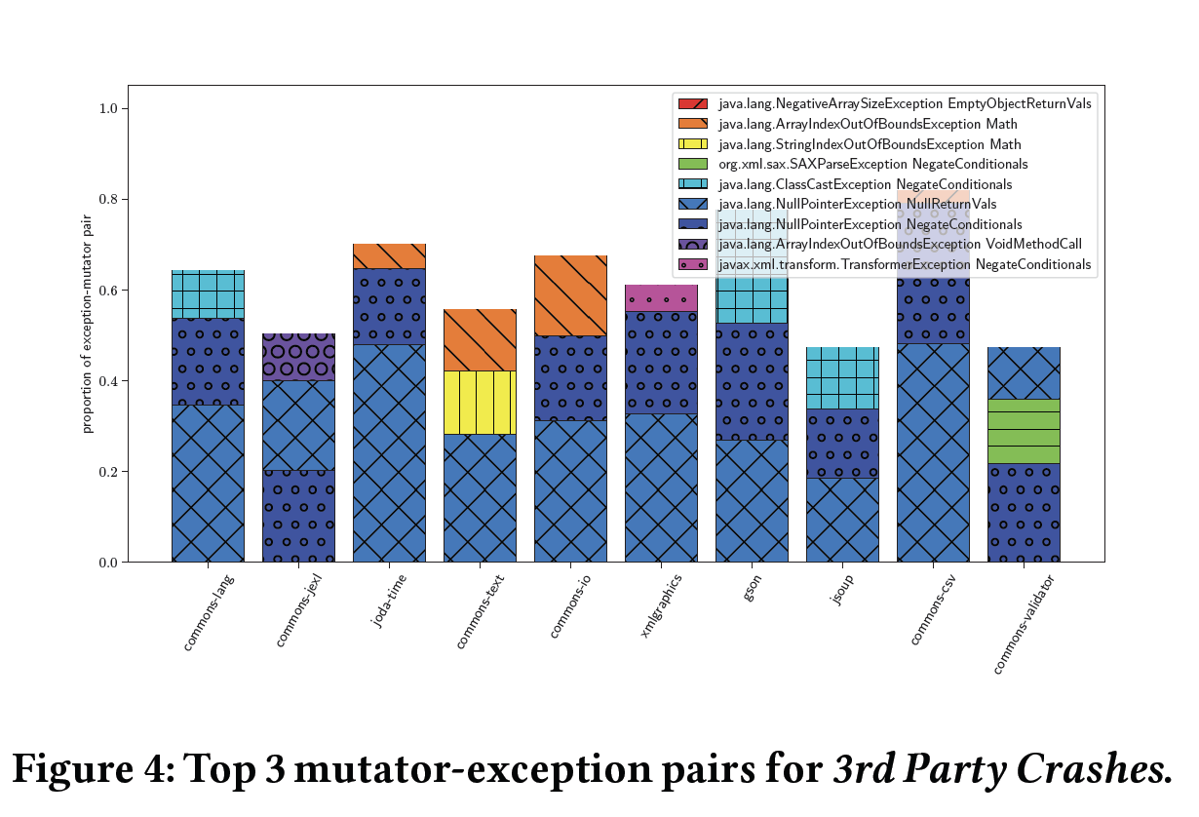

Slide 22
